Slide 1

Decision Tree Classification

Slide 2

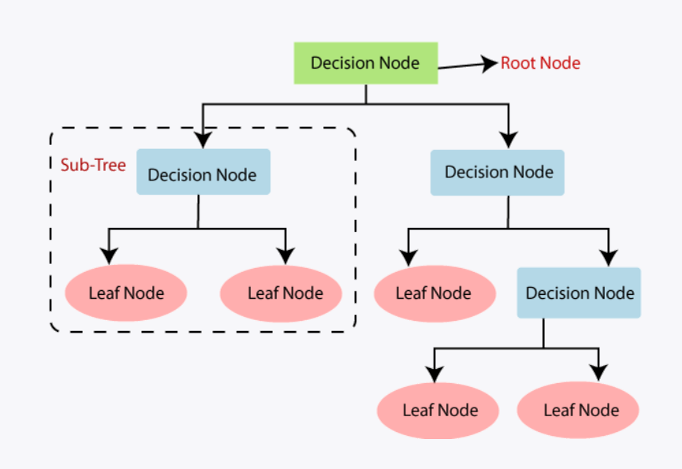
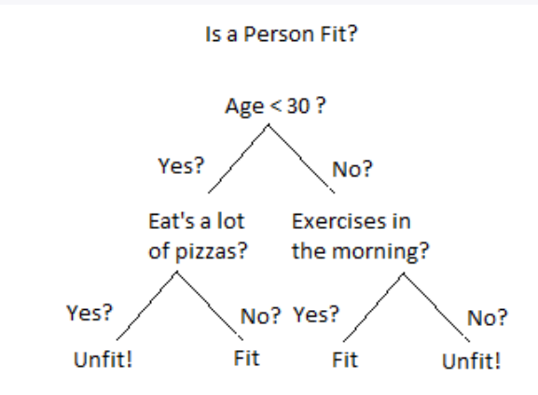
What is Decision Tree Classification
Decision tree is a flowchart like tree structure, where each internal node denotes a test on an attribute, each branch represents an outcome of the test, and each leaf node( terminal node ) holds a class label.

Slide 3
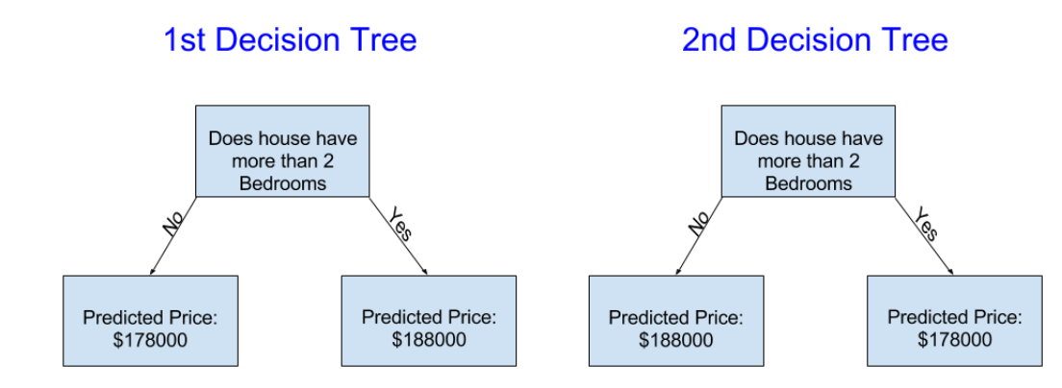

Slide 4
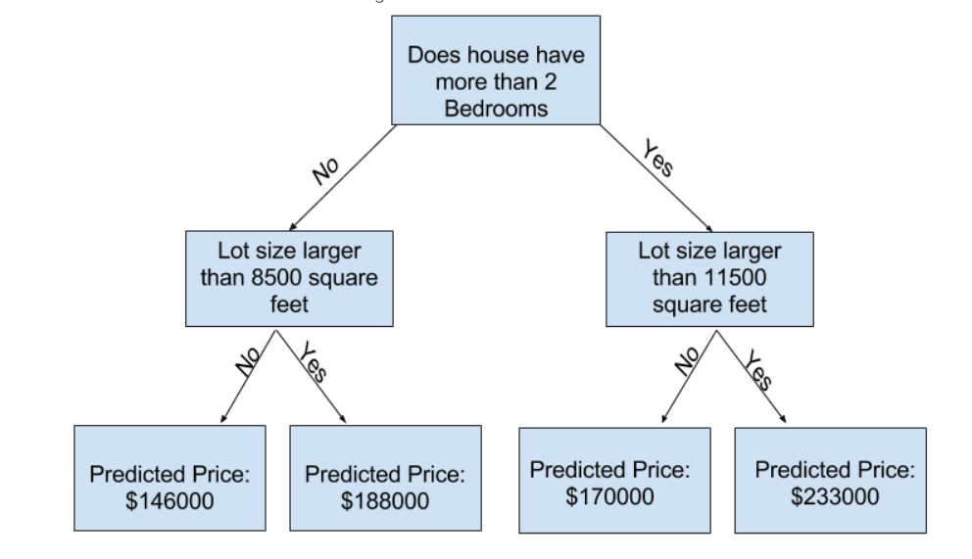

Slide 5
Applications of Decision trees
Biomedical Engineering
Medicine
Astronomy
Financial analysis
Manufacturing and Production

Slide 6
Decision Tree Classification Model
1
from sklearn.tree import DecisionTreeClassifier
2
classifier = DecisionTreeClassifier(criterion = 'entropy', random_state = 0)
3
classifier.fit(X_train, y_train)
4
y_pred = classifier.predict(X_test)

